Slide 1

B.TECH PROJECT PRESENTATION · COMPUTER SCIENCE & ENGINEERING
CLEARVISION
Image Quality Enhancement System
Hooghly Engineering &
Technology College, Hooghly
SUBMITTED BY
Affiliated to Maulana Abul Kalam Azad
University of Technology, West Bengal
Shouvik Dutta Banik
Roll No. 17600122068
Aditya Sharma
Roll No. 17600122065
Tarun Masanta
Roll No. 17600122024
Akash Verma
Roll No. 17600122025
UNDER THE GUIDANCE OF
Mr. Shyamal Pal
Assistant Professor, Department of CSE
4th YEAR · 8th SEMESTER | ACADEMIC YEAR 2025 – 2026

Slide 2
Introduction
COMMON IMAGE QUALITY PROBLEMS
1
Noise
WHAT IS IMAGE ENHANCEMENT?
Grainy pixels from low-quality sensors or poor lighting
The process of improving an image's visual appearance — clarity, contrast, sharpness, and colour — for human viewing, while preserving essential information. Unlike restoration, enhancement focuses on visual appeal rather than recovering a “original” state.
2
Low Contrast
Flat, washed-out tones hide important detail
CLEARVISION AT A GLANCE
3
Blur
A web-based system combining four enhancement techniques in one pipeline
Soft edges make images difficult to interpret
Built with HTML, CSS and JavaScript — runs entirely inside the browser
4
Dull Colors
Faded, lifeless colors reduce visual appeal
No installation, no server upload — fast, private, accessible
Clearvision | 02

Slide 3
Problem Statement
Traditional editing tools and single-algorithm enhancers each solve only part of the problem. Clearvision integrates the strongest techniques from the literature into one lightweight browser pipeline.
FEATURE
EXISTING SYSTEMS
PROPOSED CLEARVISION SYSTEM
Enhancement Techniques
Single or limited algorithms
Multiple integrated techniques
Software Requirement
Installation required
Browser-based, no installation
Processing
Desktop or server-based
Client-side processing
User Privacy
Images may be uploaded to servers
Images stay on the local device
User Control
Limited customization
Adjustable levels & algorithm selection
Image Comparison
Basic preview
Side-by-side & slider comparison
Clearvision | 03

Slide 4
Objectives
Remove image noise while preserving edges
Improve local image contrast
✓
✓
Sharpen edges and fine details
Enhance and enrich image colours
✓
✓
Compare original vs. enhanced images instantly
Allow one-click download of results
✓
✓
Maintain complete user privacy
Run entirely inside the browser — no install
✓
✓
Clearvision | 04

Slide 5
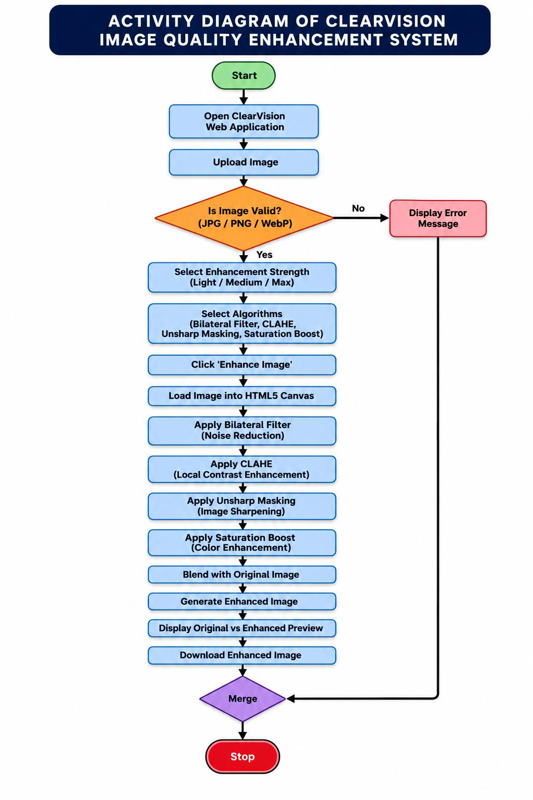
System Workflow
1
Open the ClearVision web application & upload an image
2
Validate format (JPG / PNG / WebP)
3
Select enhancement strength — Light, Medium or Max
4
Choose algorithms and click “Enhance Image”
5
Image loads into the HTML5 Canvas for pixel-level processing
6
Sequentially apply Bilateral Filter → CLAHE → Unsharp Masking → Saturation Boost
7
Blend with original & generate the enhanced image
8
Preview original vs. enhanced, then download
Clearvision | 05

Slide 6
Platform & Technology
HTML5
CSS3
JavaScript
Structures the interface — upload controls, enhancement options and the Canvas workspace for pixel-level manipulation.
Delivers a clean, responsive layout — buttons, panels, comparison sliders and animations across screen sizes.
Drives every function: uploads, enhancement algorithms, comparison, and downloads — all client-side.
HTML5 Canvas
FileReader API
Cross-Browser
The core processing platform. Reads pixel data with getImageData() and writes results with putImageData().
Loads local image files directly into the browser — no server round-trip, faster and more private.
Runs on Chrome, Edge and Firefox across Windows, Linux and macOS with no platform-specific code.
Clearvision | 06

Slide 7
Project Modules
All processing runs locally in the browser — no server upload, faster execution, complete data privacy.
01
02
03
04
05
Image Upload
Enhancement Config
Image Processing
Result Preview
Download
Select an image via FileReader; validates JPG / PNG / WebP and loads it onto the canvas.
→
Choose enhancement strength — Light, Medium or Max — and pick one or more techniques.
→
Core module: applies Bilateral Filter, CLAHE, Unsharp Masking and Saturation Boost in sequence.
→
Displays the output with side-by-side view and an interactive comparison slider.
→
Converts the processed canvas into an image file for one-click download.
Clearvision | 07

Slide 8
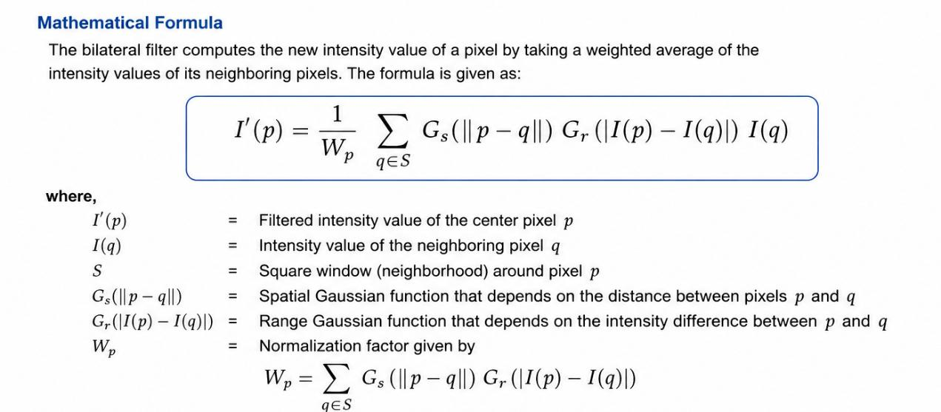
Bilateral Filter
An edge-preserving smoothing filter. It reduces noise by averaging neighbouring pixels, weighted by both spatial distance and intensity similarity — so it smooths flat regions without blurring edges.
ALGORITHM
Input: Original Image Output: Noise-reduced Image
1
Read the uploaded image from the HTML5 Canvas
2
Select a neighbourhood around each pixel
3
Calculate spatial weight based on pixel distance
4
Calculate intensity weight based on intensity difference
5
Multiply both weights to get the final weight
WHY IT COMES FIRST
Bilateral filtering is applied as the first enhancement step. It cleans the image of unwanted noise while preserving edges — giving CLAHE and Unsharp Masking a clean, reliable input to work with.
6
Compute the weighted average of neighbouring pixels
7
Replace the original pixel with the filtered value
8
Repeat for all pixels and return the filtered image
Clearvision | 08

Slide 9
CLAHE (Contrast Limited Adaptive Histogram Equalization
ALGORITHM
Input: Noise-reduced image Output: Contrast-enhanced image
1
Read the filtered image
2
Divide the image into small tiles
3
Compute the histogram of each tile
4
Apply the clip limit to each histogram
5
Redistribute the clipped pixels uniformly
6
Perform histogram equalization on each tile
7
Interpolate neighbouring tiles to remove boundaries
8
Generate the enhanced output image
Clearvision | 09

Slide 10
Unsharp Masking & Saturation Boost
UNSHARP MASKING — Sharpening
SATURATION BOOST — Colour Enhancement
Subtracts a blurred copy from the original image to sharpen edges.
Boosts saturation in HSL space without affecting hue or brightness.
Sharpened = Original + Amount × (Original − Blurred)
RGB
→
HSL
→
Boost S
→
HSL
→
RGB
ALGORITHM
ALGORITHM
1
Read the contrast-enhanced image
1
Read the sharpened image
2
Generate a blurred version of the image
2
Convert each pixel from RGB to HSL
3
Compute difference: original − blurred
3
Increase saturation using the scaling factor
4
Multiply the difference by the sharpening factor
4
Restrict saturation to the valid range
5
Add the result back to the original
5
Convert modified HSL values back to RGB
6
Clip pixel values to the valid range
6
Update pixel values — generate the final image
Clearvision | 10

Slide 11
Key Features
✦
✦
Browser-Based
Client-Side Processing
JPG · PNG · WebP
No installation required
No server dependency
Broad format support
✦
3 Enhancement Levels
Multiple Algorithms
Real-Time Processing
Light, Medium, Max
Selectable per image
Instant visual feedback
✦
✦
Side-by-Side Compare
Interactive Slider
One-Click Download
Original vs. enhanced
Drag to reveal changes
Save results instantly
Clearvision | 11

Slide 12
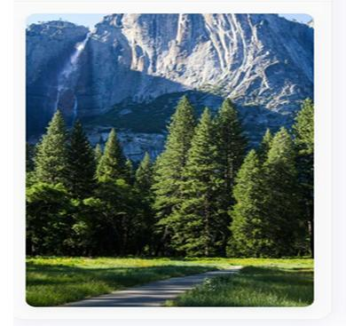
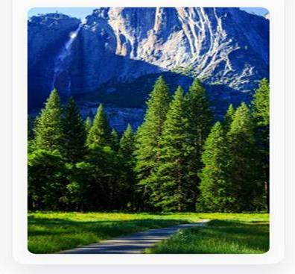
Results
TEST CASE · Landscape Photograph
ORIGINAL IMAGE
ENHANCED IMAGE
What We Started With
What We Achieved
Visible noise and grain in shadow areas
Noise reduced — cleaner shadow regions (Bilateral Filter)
Flat, low local contrast in rock texture
Local contrast improved — hidden detail revealed (CLAHE)
Softer, less defined edge detail
Edges sharpened — crisper textures (Unsharp Masking)
Muted, slightly dull colour tones
Colours enriched — richer, vibrant tones (Saturation Boost)
Clearvision | 12

Slide 13
Applications
1
2
3
4
Digital Photography
Medical Imaging
Surveillance Systems
Document Enhancement
Clearer, more vibrant photographs from poor lighting conditions
Improves visibility of X-rays, MRI and CT scans for diagnosis
Sharper, cleaner CCTV footage for identification
Restores readability of faded scans and old records
5
6
7
Remote Sensing
Social Media Content
Education & Research
Clearer satellite & aerial imagery for mapping
Quick quality boost before sharing or publishing
A practical teaching tool for image processing concepts
Clearvision | 13

Slide 14
Future Scope
AI-Based Enhancement
Batch Processing
1
2
Auto-detect image quality & recommend parameters
Enhance multiple images simultaneously
Mobile Application
Cloud Storage Integration
3
4
Native Android & iOS support
Upload, store & access from any device
Performance Optimization
More Formats
5
6
GPU acceleration & WebAssembly
Support for TIFF, RAW and BMP
Real-Time Camera Enhancement
User Profiles
7
8
Live enhancement via webcam feed
Save personalised enhancement presets
Clearvision | 14

Slide 15
Conclusion
Clearvision successfully integrates Bilateral Filtering, CLAHE, Unsharp Masking and Saturation Boost into a single, lightweight web application — improving image clarity, contrast, sharpness and colour while preserving a natural appearance.
1
2
3
4
No Server, No Compromise
Combined Techniques Win
Genuinely Accessible
A Foundation to Build On
All processing happens client-side, so images never leave the user's device.
Integrating four algorithms outperforms any single method used alone.
No installation or specialised software — works in any modern browser.
Modular design opens the door to AI, batch processing and mobile apps.
Clearvision | 15

Slide 16
THANK YOU
Questions & Discussion Welcome
CLEARVISION IMAGE QUALITY ENHANCEMENT SYSTEM
Shouvik Dutta Banik · Aditya Sharma · Tarun Masanta · Akash Verma
Guided by Mr. Shyamal Pal, Assistant Professor, Dept. of CSE
Hooghly Engineering & Technology College, Hooghly | Dept. of CSE | 2025 – 2026

